Slide 1
My Top Five DevOps Learnings:
Gene Kim

Slide 2







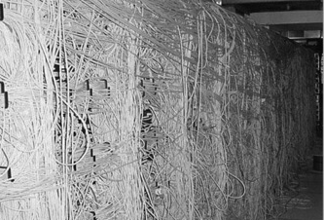
The Downward Spiral…

Slide 3
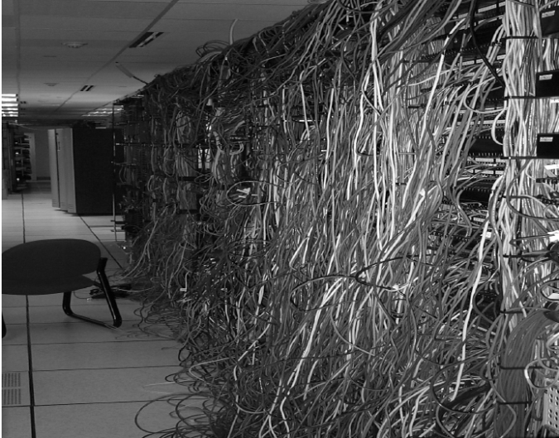
Notes:
[ picture of messy data center ] Ten minutes into Bill’s first day on the job, he has to deal with a payroll run failure. Tomorrow is payday, and finance just found out that while all the salaried employees are going to get paid, none of the hourly factory employees will. All their records from the factory timekeeping systems were zeroed out. Was it a SAN failure? A database failure? An application failure? Interface failure? Cabling error?

Slide 4
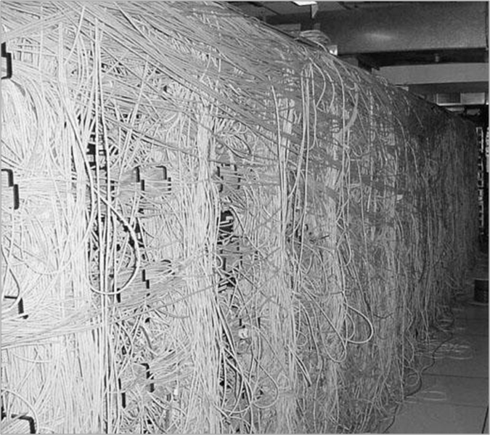

Slide 5
IT Ops And Dev At War
Notes:
Source: http://biobreak.wordpress.com/2010/10/07/games-evangelism-dos-and-donts/

Slide 6


Slide 7
Surprise #1: The Business Value Of DevOps Is Even Higher Than We Thought
Notes:
My name is Gene Kim. My area of passion started when I was the CTO and founder of Tripwire in 1999. I started keeping a list that we called “Gene’s list of people with great kung fu.” These were the organizations that simutaneously…
In the next 25 minutes, I’m really excited to share with you some of my key learnings, which I’m hoping that will not only be applicable to you, but that you’ll be able to put into practice right away, and get some amazing results.
But let me tell you how my journey began…

Slide 8
High Performers Are More Agile
30x
200x
more frequent deployments
faster lead times than their peers
Source: Puppet Labs 2015 State Of DevOps: https://puppetlabs.com/2015-devops-report

Slide 9
High Performers Are More Reliable
60x
168x
the change success rate
faster mean time to recover (MTTR)
Source: Puppet Labs 2015 State Of DevOps: https://puppetlabs.com/2015-devops-report

Slide 10
High Performers Win In The Marketplace
2x
50%
more likely to exceed profitability,
market share & productivity goals
higher market capitalization growth over 3 years*
Source: Puppet Labs 2014 State Of DevOps

Slide 11
Amazon 2010:
~15K deploys/day
Source: John Jenkins, Amazon.com (2011)

Slide 12
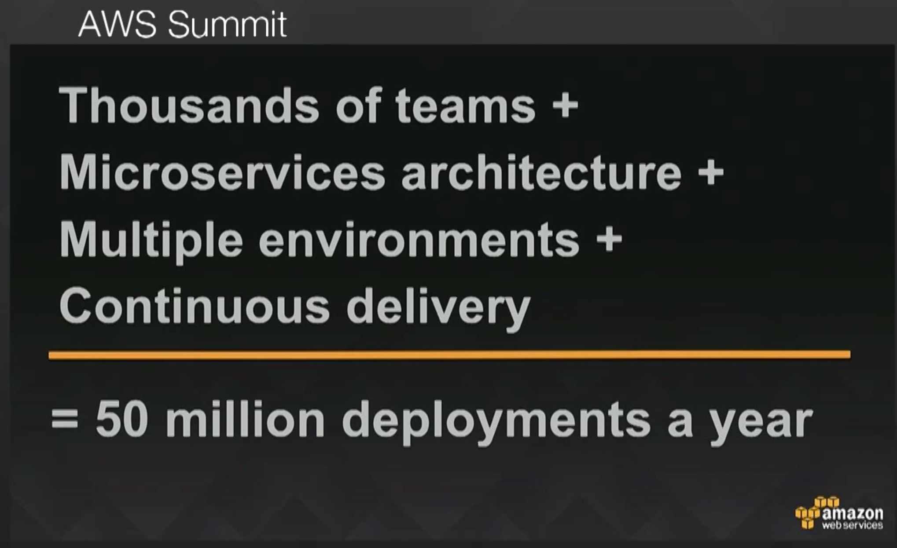
Amazon 2015:
136K deploys/day
Source: Ken Exner, Director of Dev Resources, Amazon.com (2015)

Slide 13
“deploys / day”
“deploys / day / dev”

Slide 14
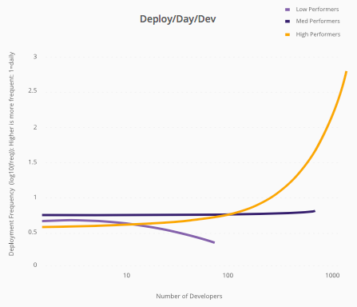
High (linear)
deploys / day
Med
Low
# of developers
Source: Puppet Labs 2015 State Of DevOps: https://puppetlabs.com/2015-devops-report

Slide 15
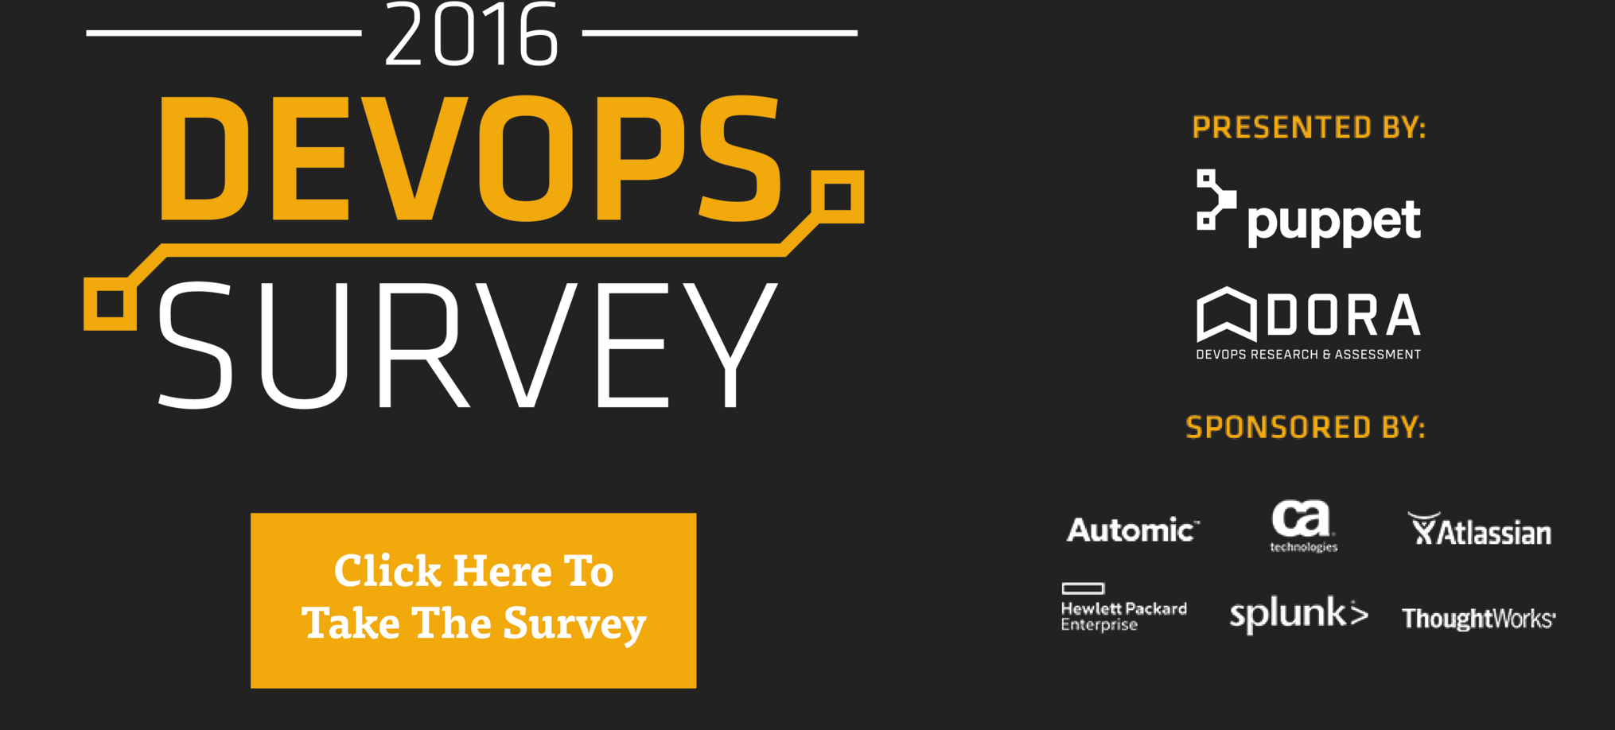
Today Is Last Chance To Take DevOps Survey!
Extended to accommodate DevOpsDays London!
Win prizes!
iPad Pro 128GB
Amazon Echo
Nest bundle or $500 Amazon gift certificate
Tickets to PuppetConf or DevOps Enterprise Summit
Lean Enterprise or upcoming DevOps Handbook
http://bit.ly/devops-survey-2016

Slide 16
Who Is Doing DevOps?
Google, Amazon, Netflix, Etsy, Spotify, Twitter, Facebook …
CSC, IBM, CA, SAP, HP, Microsoft, New Relic, …
GE Capital, Capital One, Nationwide, BNP Paribas, Amex, BNY Mellon, MasterCard, Paychex, Intuit, …
The Gap, Nordstrom, Macy’s, Williams-Sonoma, Target …
General Motors, Raytheon, LEGO, Bosche …
UK Government, US Department of Homeland Security …
Kansas State University…

Slide 17
Surprise #2: DevOps Is As Good For Ops…
Notes:
My name is Gene Kim. My area of passion started when I was the CTO and founder of Tripwire in 1999. I started keeping a list that we called “Gene’s list of people with great kung fu.” These were the organizations that simutaneously…
In the next 25 minutes, I’m really excited to share with you some of my key learnings, which I’m hoping that will not only be applicable to you, but that you’ll be able to put into practice right away, and get some amazing results.
But let me tell you how my journey began…

Slide 18
Surprise #2: DevOps Is As Good For Ops… ...As It Is For Dev!
Notes:
My name is Gene Kim. My area of passion started when I was the CTO and founder of Tripwire in 1999. I started keeping a list that we called “Gene’s list of people with great kung fu.” These were the organizations that simutaneously…
In the next 25 minutes, I’m really excited to share with you some of my key learnings, which I’m hoping that will not only be applicable to you, but that you’ll be able to put into practice right away, and get some amazing results.
But let me tell you how my journey began…

Slide 19
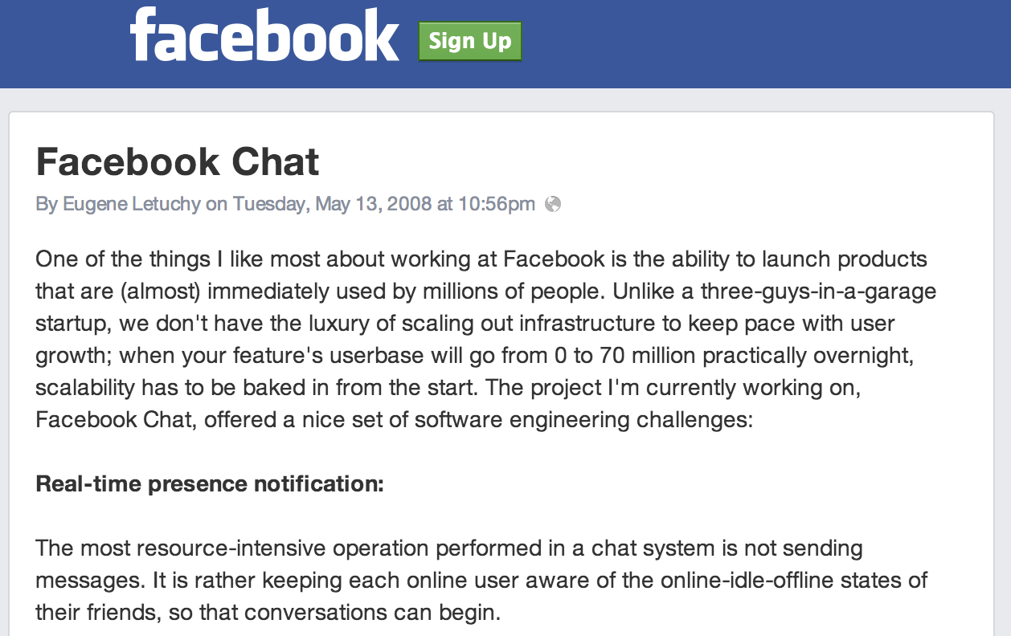

Deploy Smaller Changes, More Frequently *
Source: http://www.facebook.com/note.php?note_id=14218138919

Slide 20
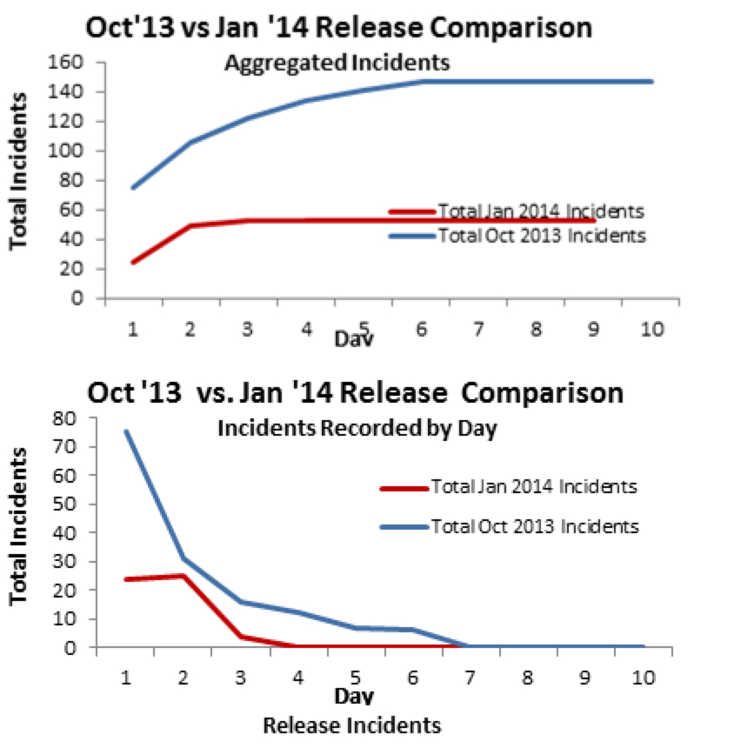
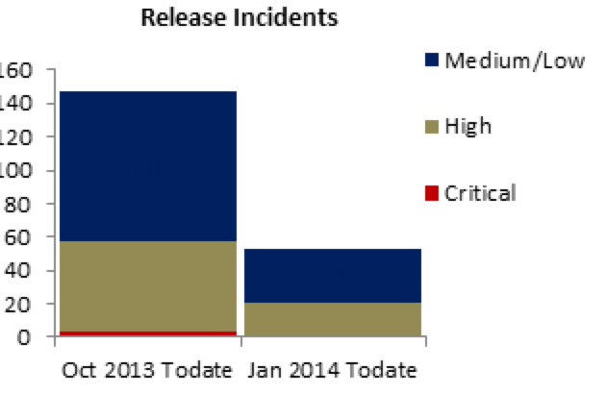
CSG: COBOL App + 20 tech stacks
And the customer got the feature in half the time!
Source: Scott Prugh, Chief Architect, CSG, Inc.

Slide 21
CSG: COBOL App + 20 tech stacks
And the customer got the feature in half the time!
Apps supporting bill printing and customer care for 50MM customer, 6B transactions per month
20 technology platforms, including mainframe VSAM and DB2, Java, desktop client
Moved from 2 to 4 releases per year
Shared Operations Team performed daily deployments to UAT
Source: Scott Prugh, Chief Architect, CSG, Inc.

Slide 22

“As a lifelong Ops practitioner, I know we need DevOps to make our work humane. In the past, I’ve worked every holiday, on my birthday, my spouse’s birthday, and even on the day my son was born.” Nathan Shimek Engineering Manager, New Context
@nathan_shimek

Slide 23
Developers Carry Pagers
“We found that when we woke up developers at 2am, defects got fixed faster than ever” – Patrick Lightbody, VP Prod Mgmt, New Relic
“You build it, you run it.” – Werner Vogels CTO, Amazon

Slide 24

“As a developer, the most satisfying points in my career? “It’s when I wrote the code, pushed the button to deploy it, watched the metrics to see if it actually worked in production, and fixed it if it broke.” Tim Tischler Director of Operations Engineering Nike, Inc.

Slide 25
Dev And Ops: We’re Both Engineers
Notes:
Mountain West Ruby Conference: Yukihiro Matsumoto, creator of Ruby was attending! Joshua Timberman, Chef

Slide 26
Dev And Ops: We’re Both Engineers
The top predictor of IT performance and organizational performance was…

Slide 27
Dev And Ops: We’re Both Engineers
The top predictor of IT performance and organizational performance was…
...whether Ops put production artifacts into version control!

Slide 28
Surprise #3: The Importance Of Measuring Code Deployment Lead Time
Notes:
My name is Gene Kim. My area of passion started when I was the CTO and founder of Tripwire in 1999. I started keeping a list that we called “Gene’s list of people with great kung fu.” These were the organizations that simutaneously…
In the next 25 minutes, I’m really excited to share with you some of my key learnings, which I’m hoping that will not only be applicable to you, but that you’ll be able to put into practice right away, and get some amazing results.
But let me tell you how my journey began…

Slide 29
“deploys per day”
vs.
“lead time”

Slide 30
“What is your lead time for changes?” “How long does it take to go from code committed to code successfully running in production?”

Slide 31
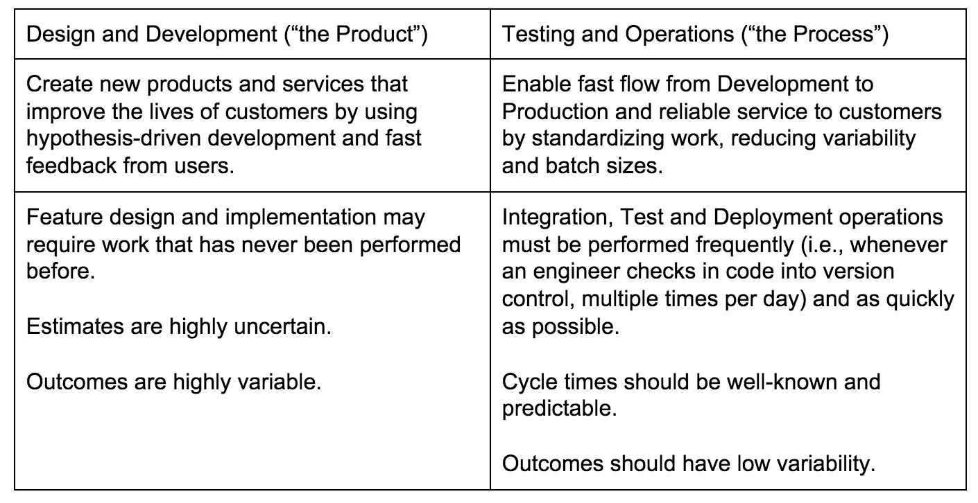
Source: DevOps Handbook (upcoming)

Slide 32
Deployment Lead Time Predicts…
Ability for Dev and Ops to share a “common source of truth”
Effectiveness of our automated testing in the deployment pipeline
Ability to quickly deploy into production without causing chaos and disruption
Ability to detect and correct problems through monitoring
Ability for Dev and Ops to work together in a way that is “win / win”
How quickly developers can get feedback on their work
Testing, deploying, production outcomes, customer outcomes

Slide 33
“In November 2011, running even the most minimal test for CloudFoundry required deploying to 45 virtual machines, which took a half hour. This was way too long, and also prevented developers from testing on their own workstations. By using containers, within months, we got it down to 18 virtual machines so that any developer can deploy the entire system to single VM in six minutes.” — Elisabeth Hendrickson, VP Engineering, Big Data Suite, Pivotal
@testobsessed
Notes:
Sam Lambert, GitHub presentation yesterday

Slide 34
What Is The One Question That Predicts Performance With Startling Accuracy?

Slide 35
“To what degree do we fear doing deployments?”
Source: Puppet Labs 2015 State Of DevOps: https://puppetlabs.com/2015-devops-report

Slide 36
IT Performance And Org Performace
Deployment frequency: 30x higher
Deployment lead time: 200x faster
Change success rate: 60x higher
MTTR: 168x faster
Likelihood achieving org goals: 2x higher

Slide 37
Surprise #4: DevOps Enables Dynamic, Learning Organizations… And Learnings Belong In A Shared Repo!

Slide 38

Dr. Steven Spear
“While designing perfectly safe systems is likely beyond our abilities, safe systems are close to achievable” when the four following conditions are met…”
Source: Dr. Steven Spear

Slide 39
Dr. Steven Spear’s Four Capabilities
See problems as they occur
Swarm and solve problems to create new knowledge
Spread new knowledge throughout the organization
Leaders create new leaders
Source: Dr. Steven Spear

Slide 40
Capability 1
See problems as they occur:
Complex work is managed so that problems in design are revealed
They see problems as they occur, through relentless testing of assumptions
Automated testing in the deployment pipeline, proactive monitoring of the production environment, …
Source: Dr. Steven Spear

Slide 41
Capability 2
Swarming and solving problems as they are seen to build new knowledge
Problems that are seen are solved so that new knowledge is built quickly
Improvement of daily work is prioritized above daily work
Stopping work when builds, tests, deployments and services break, enabling fast feedback loops, especially to Dev…
Source: Dr. Steven Spear

Slide 42
Capability 3
Spreading new knowledge throughout the organization
The new discovery of local knowledge and improvements are turned into global improvements, shared throughout the organization
Learning is fed back into the system to prevent future failures
High trust culture, blameless post-mortems when things go wrong, single source code repositories, internal conferences…
Source: Dr. Steven Spear

Slide 43
DevOps Practices In Capability 3
Blameless post-mortems
Learning days and internal technology conferences
Embracing open source
Single, shared source code repositories

Slide 44
Google Dev And Ops (2013)
15,000 engineers, working on 4,000+ projects
All code is checked into one source tree (billions of files!)
5,500 code commits/day
75 million test cases are run daily
"Automated tests transform fear into boredom." -- Eran Messeri, Google

Slide 45
“The best architecture document is one that is implemented in code, in a shared source code repository, that anyone can pull from.” — Justin Arbuckle, Former Chief Architect, GE Capital
“Any Google engineer has a wealth of libraries already available to them. Almost everything has already been done.” — Rachel Potvin, Engineering Manager, Google
“One of the primary benefits of one repository is that you can see all the code, and you always get latest version, without any effort or coordination.” — Eran Messeri, Engineer, Google

Slide 46
“[The result of Admiral Rickover creating this capability] was that a young crew and their officers setting out for their first cruise on a US naval vessel benefits from the collective experience gained from over 5,700 reactor-years of experience behind them.”
— Dr. Steven Spear

Slide 47
Capability 4
Leading by developing
The job of leaders is not to command and control, but to create other capable leaders who can perpetuate this system of work
“My goal is not to direct and control, but to guide and enable”
Source: Dr. Steven Spear

Slide 48
We must seek to create as much feedback in our system, from as many areas in our system, sooner, faster, and cheaper, with as much clarity between cause and effect. Why? Because the more assumptions we can invalidate, the more we learn, improving our ability to fix problems and innovate.

Slide 49
“Culture isn’t just touchy-feely kumbahyah. Instead, it is the consistent response by a group of people to conditions. When we change culture, we fundamentally shift how people respond to a situation.
– Dr. Steven Spear

Slide 50
Surprise #5: DevOps Is For The Unicorns…

Slide 51
Surprise #5: DevOps Is For The Unicorns… ...And The Horses, Too

Slide 52
DevOps Enterprise Summit
In 2015, we held the second DevOps Enterprise Summit, a conference for horses, by horses
Speakers included fifty leaders from:
Barclays Capital, GE Capital, Marks and Spencer, UK.gov, Macy’s, Disney, Target, GE Capital, Western Union, Sherwin Williams, Blackboard, Nordstrom, Telstra, US Department of Homeland Security, CSG, Raytheon, IBM, Ticketmaster, MITRE, Microsoft, Nationwide Insurance, Capital One, Fidelity, Rally Software, Neustar, Walmart, PNC, ADP, …

Slide 53
Observations
They were using the same technical practices and getting the same sort of metrics as the unicorns
Target: 100+ deploys per week, < 10 incidents per month, enabled 53 business initiatives
Capital One: 100s of deploys per day, lead time of minutes
Macy’s: 1,500 manual tests every 10 days, now 100Ks automated tests run daily
Disney: Has embedded nearly 100 Ops engineers into LOB teams across the enterprise
Nationwide Insurance: Retirement Plans app (COBOL on mainframe)
Raytheon: testing and certification from months to a day
US CIS: security and compliance testing run every code commit

Slide 54
Observations
The transformation stories are among the most courageous I’ve ever heard –
Often the transformation leader was putting themselves in personal jeopardy
Why? Absolute clarity and conviction that it was the right thing for the organization

Slide 55
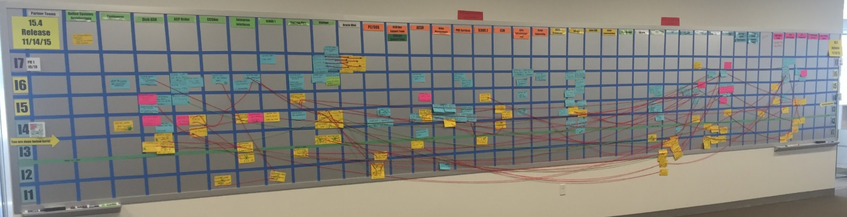

1b. Dependency Visibility
Make your team and system dependencies visible. Leverage this to increase understanding, unwind handoffs and move towards feature teams.
41 Teams
7 Iterations
“Conway’s Board”
http://www.scaledagileframework.com/release-planning
Notes:
1:00/12:30
This is Row1 for our software development program. This is a picture of our “program board”. On the vertical we have time: 7 iterations. On the horizontal you have the teams. There are 41.
The blue cards represent features. The yellow cards represent dependencies. The strings link the features to their dependencies.
This overall picture gives us a visual of our dependencies between component teams required to deliver a feature.
Conway predicted that 4 teams would create a 4 pass compiler. This to me looks like a 41 pass compiler.
By making our dependencies visible we can begin to understand handoffs and move towards feature teams.
One final note: This picture DOES NOT include all the operations teams required to deliver the solution.

Slide 56
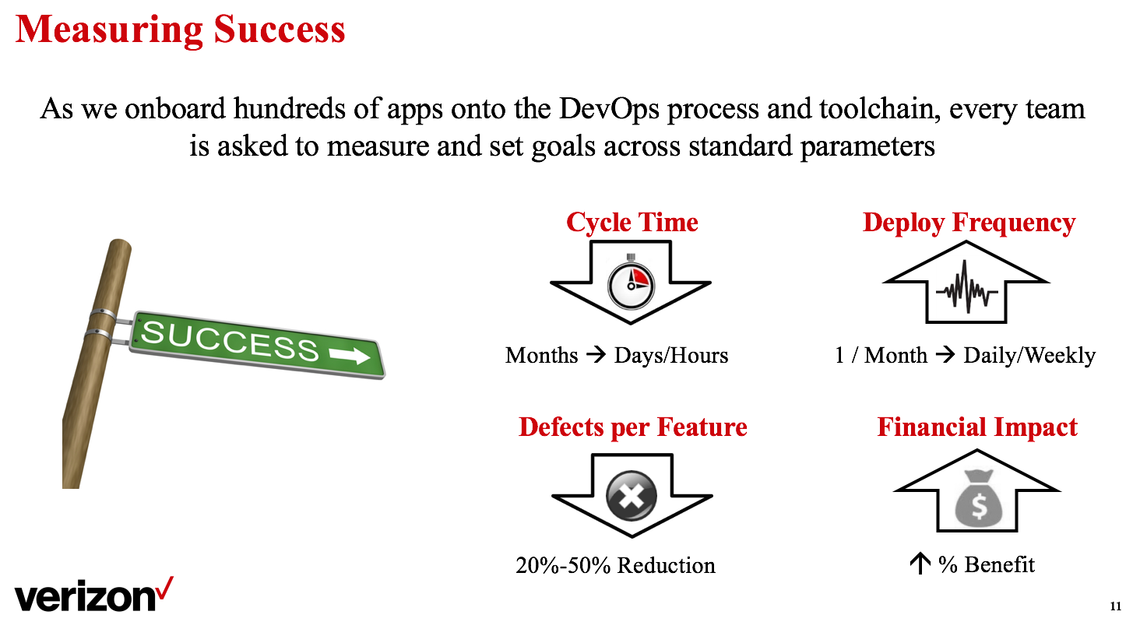
Chivas Nambiar, Verizon

Slide 57
Heather Mickman, Target, Inc.
Abolished the TEP-LARB process
As a result, she won the Lifetime Achievement Award from her grateful team

Slide 58
Why Do I Think This Is Important?

Slide 59
The Downward Spiral…

Slide 60
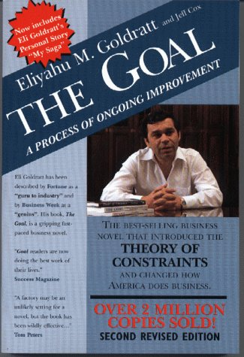

Slide 61

“This book will have a profound effect on IT, just as The Goal did for manufacturing.” –Jez Humble, co-author Continuous Delivery
“This is the IT swamp draining manual for anyone who is neck deep in alligators.” –Adrian Cockroft, Cloud Architect at Netflix
“This is The Goal for our decade, and is for any IT professional who wants their life back.” –Charles Betz, IT architect, author “Architecture and Patterns for IT”

Slide 62

DevOps Enterprise Summit 2016
Join fellow technology leaders of large, complex organizations implementing DevOps principles and practices for 2 days of keynotes, panels, and breakout sessions across all industries.
EARLY BIRD TICKETS: £600 +VAT (ENDS 2 MAY)
Use code devopsdays for an extra 20% off!
For more info and to purchase tickets visit:
events.itrevolution.com/eu
Speakers announced from Pearson, Disney, Lebara, LV=, News UK, UK Ordnance Survey, Thomas Cook Group, TicketMaster…
Notes:
Programming committee: Markos Rendell, Benjamin Wootton, Ben Grinnel

Slide 63
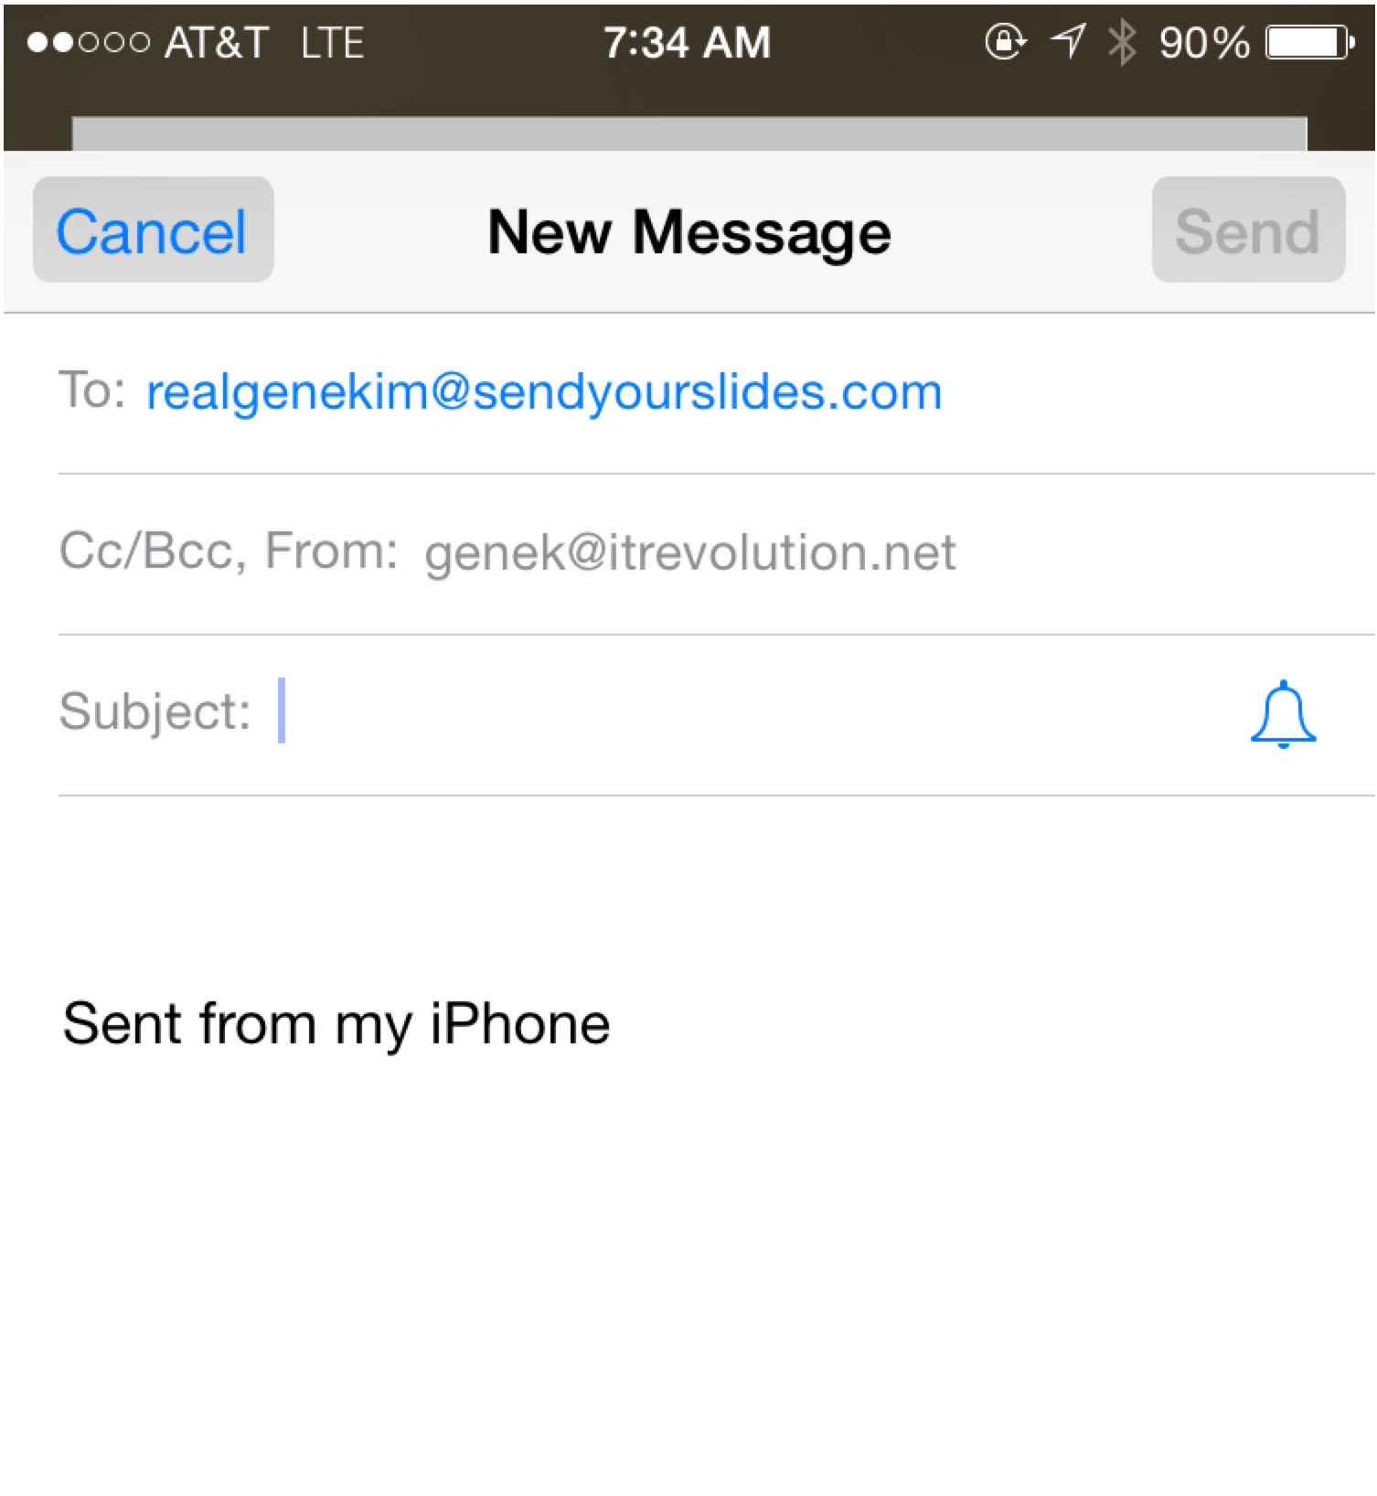
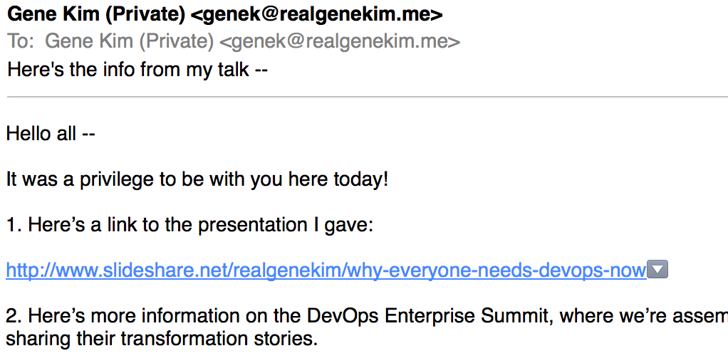
Interesting In Learning More?
To receive the following:
A copy of this presentation
20% discount to DevOps Enterprise Summit London
All videos/slides from DevOps Enterprise 2014 & 2015
The 140-page excerpt of The Phoenix Project
One-hour excerpt of The Phoenix Project audiobook
Link to the DevOps Audit Defense Toolkit
See early drafts of our upcoming DevOps Handbook
Just pick up your phone and send an email:
To: realgenekim@SendYourSlides.com
Subject: ukdevops
realgenekim@SendYourSlides.com
ukdevops

Slide 64
Surprise #4: DevOps Is Awesome For Infosec
Notes:
My name is Gene Kim. My area of passion started when I was the CTO and founder of Tripwire in 1999. I started keeping a list that we called “Gene’s list of people with great kung fu.” These were the organizations that simutaneously…
In the next 25 minutes, I’m really excited to share with you some of my key learnings, which I’m hoping that will not only be applicable to you, but that you’ll be able to put into practice right away, and get some amazing results.
But let me tell you how my journey began…

Slide 65
Notes:
So who are all these constituencies that we can help, and increase our relevance as Tripwire practitioners and champions?
How many people here are in infosec?
Goal: protect critical systems and data
Safeguard organizational commitments
Prevent security breaches, help quickly detect and recover from them
Bad day: no security standards
No one is complying
Yes, we’re 3 years behind. “Whaddya gonna do about it?”
Vs. we (Tripwire owner) can become more relevant and add value by help infosec by leveraging all the configuration guidance out there
Measure variance between produciton and those known good states
Trust and verify that when management says, we’ve trued up the configurations, they’ve actually done it
Why? Now, more than ever, there are an ever increasing amount of regulatory and contractual requirements to protect systems and data

Slide 66
10 deploys per day Dev & ops cooperation at Flickr John Allspaw & Paul Hammond Velocity 2009
Source: John Allspaw (@allspaw) and Paul Hammond (@ph)

Slide 67
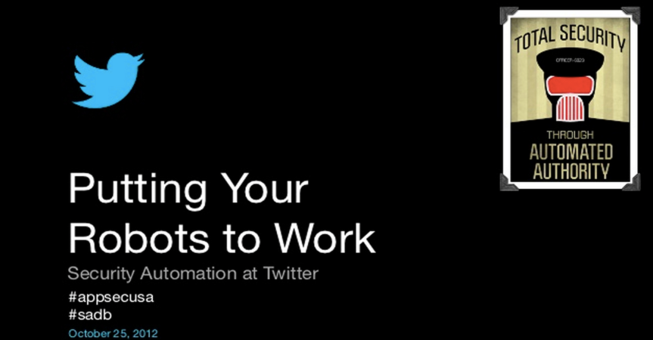


Slide 68
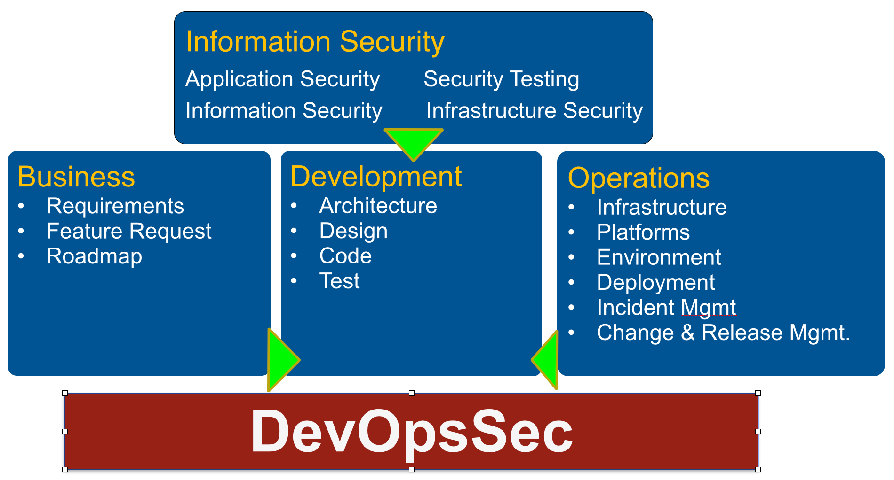
Capital One: DevOpsSec
Source: Tapabrata Pal, Capital One

Slide 69
An ATM Story…

Slide 70
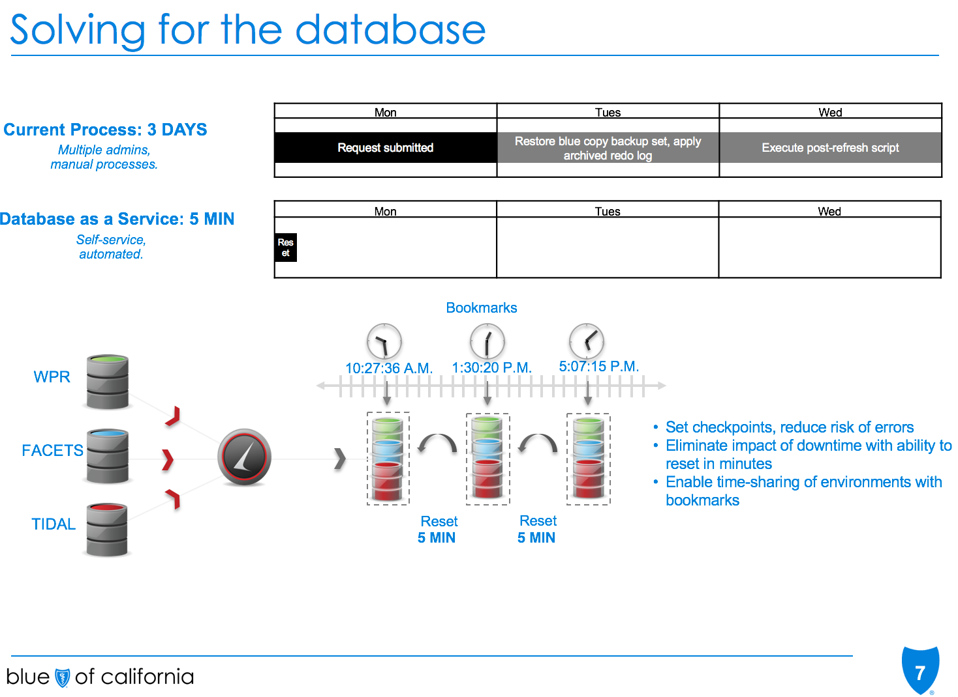
Michael Hrenko, Blue Shield of CA

